Slide 1
?
What insurance does an event planner need
&
what does the customer need
The what and why questions and answers about insurance exposures to venues, event planners, and their customers.

Slide 2

Presented by Larry Cossio
Licensed agent/broker since 1979
Owner of Cossio Insurance Agency
Member of ISES
Speaker on insurance since 1980

Slide 3
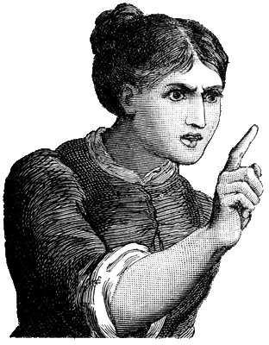
We insure every activity your mother told you not to do...

Slide 4
Let's get the facts straight...
There are 5 main facts that you must know today:
1.
You hate insurance
2.
Your customer hates
insurance
3.
I hate insurance more

Slide 5
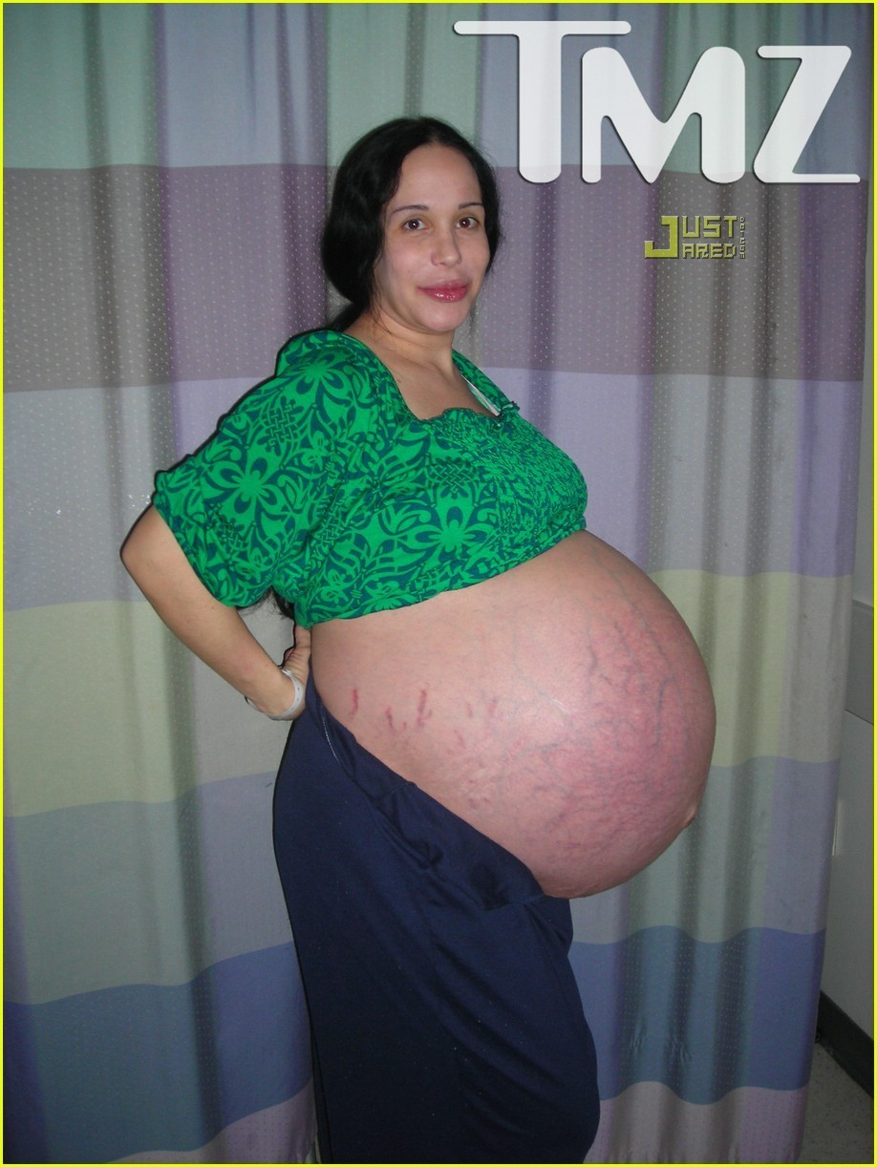
4.
You can't be a little bit pregnant

Slide 6
5.
You need counseling for coming to an insurance class
What were you thinking????

Slide 7
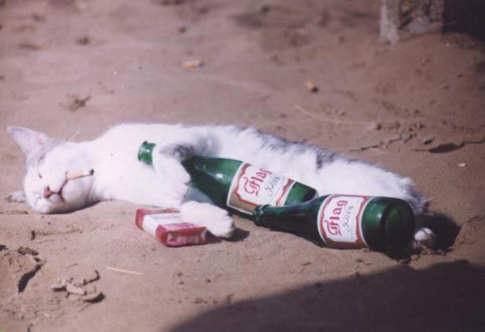

After my presentation today
Before my presentation
I get a commission from the bar
tab after my presentations...

Slide 8
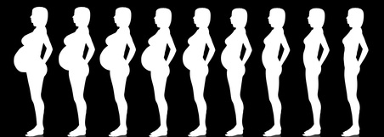
Either you have the correct coverage or you don't.
If you only remember one thing today…
1
You can't be a little bit pregnant!
Either you have the correct coverage or you don't.

Slide 9
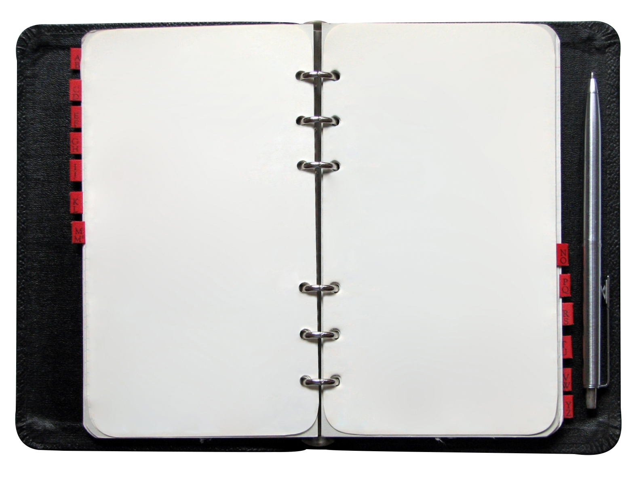
Today's Agenda
1.
Event Planner Insurance
2.
Venue Insurance
Requirements
3.
Customer Insurance Needs
4.
Subcontractor
Insurance Needs
5.
What is a Certificate
of Insurance?
6.
What To Do in Case
of an Incident

Slide 10
The top 4 things that event planners say about insurance are:
1.
All I want is the certificate
of insurance
2.
I don't care if it covers anything, the venue just wants one
3.
I have a copy of their certificate from last year
4.
We don't have time to follow up on this insurance stuff

Slide 11
Event Planner Insurance Needs
General Liability
Professional Liability
Workers
Compensation
Property & Inland
Marine Coverage
Commercial Auto
EPLI Coverage

Slide 12

And the most important thing an Event Planner needs...

Slide 13
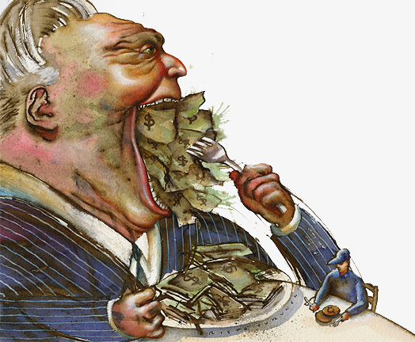
But why do I need insurance?
Because of hungry attorneys

Slide 14

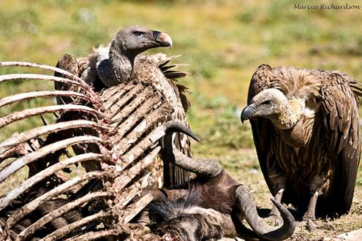
They are attorney's
These are not Eagles

Slide 15
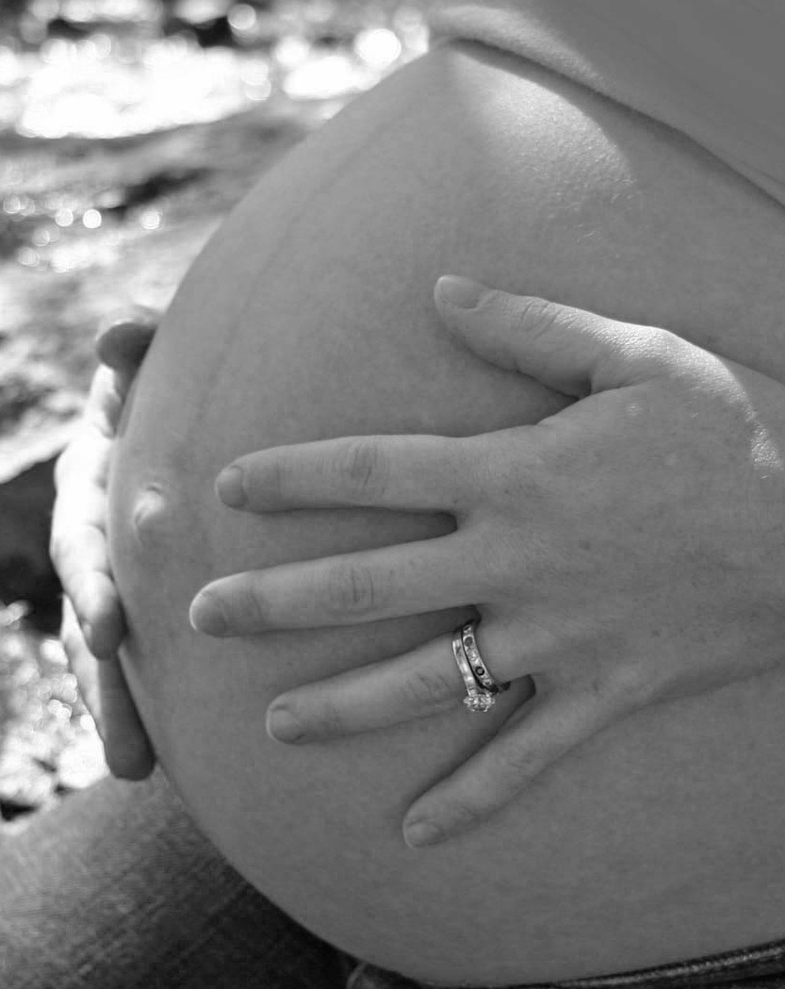
REMEMBER!
You can't be a little bit pregnant!
You can't be a little pregnant.

Slide 16
Entities that would be named in a lawsuit by the customer
Caterer
Tent Rental
Event Planner
Entertainment
Venue
Customer
So if there is a claim for a covered activity during setup, during the event, or take down, the general liability policy would provide defense coverage for negligence of the NAMED insured.
Activities
Stage
Decorations

Slide 17
General Liability
Coverage is provided for claims of bodily injury or property damage liability on your premises or at your customer's location or event location.
Important Note: Remember that some policies may exclude Errors and Omissions type claims related to the delivery of your professional services.

Slide 18
Event Planner Insurance Needs
General Liability
Professional Liability
Workers
Compensation
Property & Inland
Marine Coverage
Commercial Auto
EPLI Coverage

Slide 19
Professional Liability
Professional Liability Insurance or Errors & Omissions insurance protects you against loss from a claim of alleged negligent acts, errors or omissions in the performance of your professional services. This might include claims of non-performance, fraud or negligent oversell.

Slide 20
Failure To Provide Services
If they fail to use the degree of skill expected of them, they can be held responsible in a court of law for any harm they cause to another person or business. When liability is limited to acts of negligence, professional liability insurance may be called "errors and omissions".

Slide 21
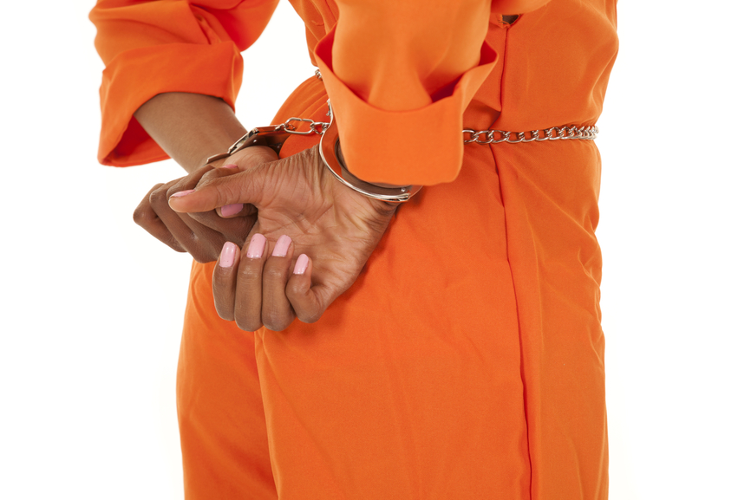
I never promised
I would do that!

Slide 22
E&O or Professional Liability Policies
Most professional liability insurance policies are issued on a claims-made basis. Coverage is only provided for activities or work that is done during the policy period and for claims that are reported during the policy period.

Slide 23
E&O or Professional Liability Policies
Remember, if a claim is made & the insurance policy is cancelled, and you make no provision for an extended reporting period, then all coverage stops and it is as if you never had a policy.
A claims made policy is cheaper than an occurrence policy.
Buy an occurrence policy if it is available!

Slide 24
Event Planner Insurance Needs
General Liability
Professional Liability
Workers
Compensation
Property & Inland
Marine Coverage
Commercial Auto
EPLI Coverage

Slide 25
Workers Compensation
This coverage is for employees
Does not cover YOU
Mandatory in most states
Does not cover sub contractors

Slide 26
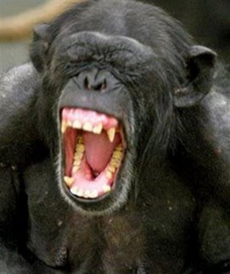
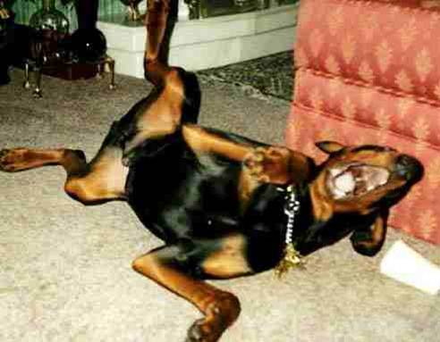
World's greatest saying,
"they are not employees"...
Sure they aren't...
the IRS is laughing at you!
IRS Agents are laughing at you...

Slide 27
REMEMBER!
You can't be a little bit pregnant!
You can't be a little pregnant.

Slide 28
Workers Compensation
This coverage is used to comply with the Workers Compensation Coverage required by your state law. Under this requirement, an employee can be compensated if he or she is injured while working for you, regardless of your negligence as an employer.

Slide 29
Event Planner Insurance Needs
General Liability
Professional Liability
Workers
Compensation
Property & Inland
Marine Coverage
Commercial Auto
EPLI Coverage

Slide 30
Property Coverage
This provides coverage for your business property on your location for fire, theft, vandalism
Covers computers, office equipment, etc.
This does NOT provide coverage for
equipment of others rented or borrowed

Slide 31
Inland Marine
This provides coverage for property you own while in transport or mobile in nature
Provides fire, theft, vandalism coverage’s

Slide 32
Event Planner Insurance Needs
General Liability
Professional Liability
Workers
Compensation
Property & Inland
Marine Coverage
Commercial Auto
EPLI Coverage

Slide 33
Commercial Auto
This coverage provides liability, medical, uninsured motorist, under-insured motorist, collision, comprehensive, rental car reimbursement and towing.
Your personal auto policy has a “business use” exclusion

Slide 34
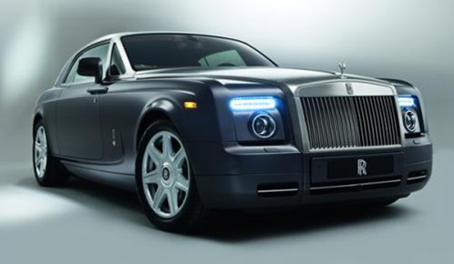
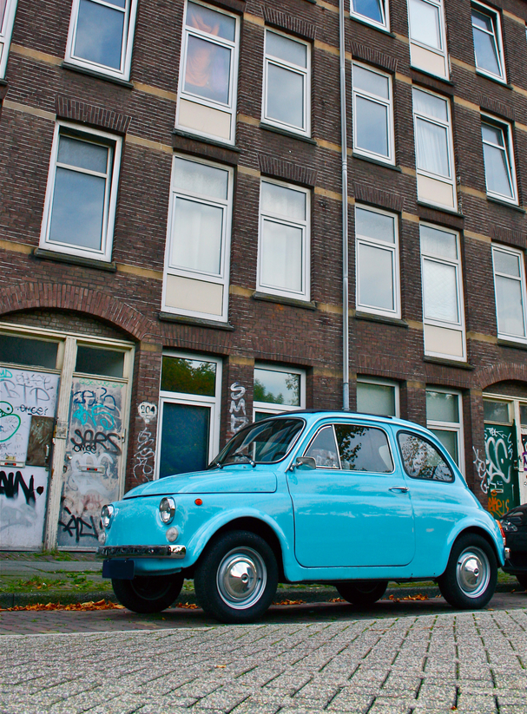

Your Company Car in 2008
Your Company Car NOW

Slide 35
Commercial Auto
Make sure your agent gives you something in writing that states your personal auto coverage protects you while using your car in your business.
If you use your vehicle in the course of business, you need to have a commercial auto policy. If you do any delivery, if you are picking up customers etc. If you just use your vehicle to go to do proposals to drive to site, you can get a business endorsement on most personal auto policies that will cover you.

Slide 36
REMEMBER!
You can't be a little bit pregnant!
You can't be a little pregnant.

Slide 37
Non-Owned Auto / Hired Car
Non-owned coverage protects the company if an employee has an accident in his or her own vehicle while on company business and the employee’s personal insurance is inadequate to cover the claim, resulting in a suit against your company.
Hired auto coverage protects your business if you or an employee rents a vehicle in the company name and an accident occurs.

Slide 38
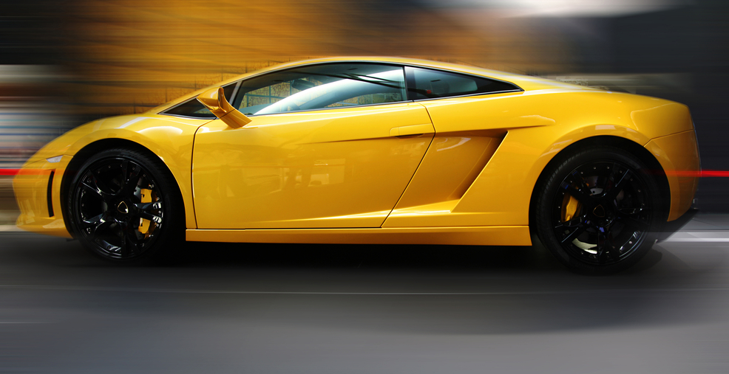
Hired Auto provides coverage for Rental Cars

Slide 39
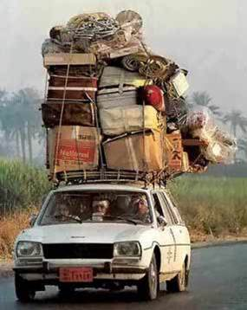
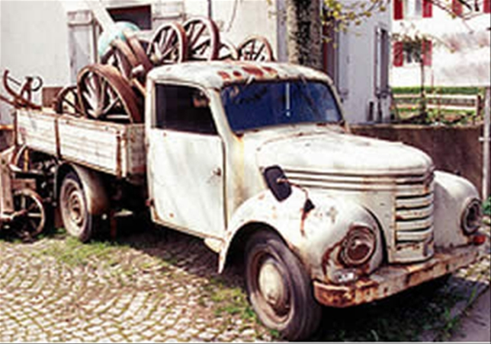
Do you use your vehicle to deliver?
Please insure
the cargo...

Slide 40
Event Planner Insurance Needs
General Liability
Professional Liability
Workers
Compensation
Property & Inland
Marine Coverage
Commercial Auto
EPLI Coverage

Slide 41
EPLI Coverage
Employment Practices Liability Insurance
EPLI covers businesses against claims by workers that their legal rights as employees of the company have been violated.
The number of lawsuits filed by employees against their employers has been rising. While most suits are filed against large corporations, no company is immune to such lawsuits.

Slide 42
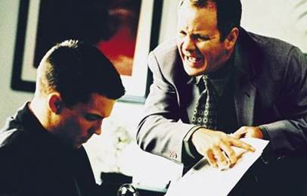
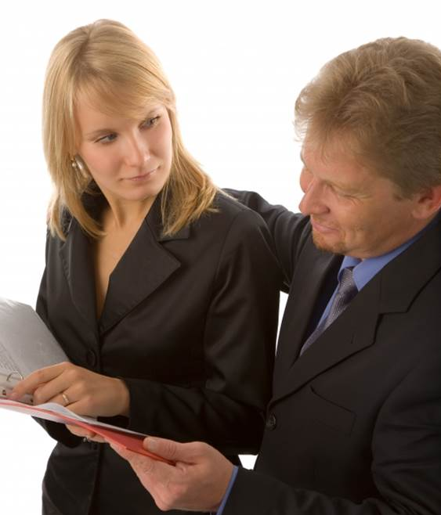
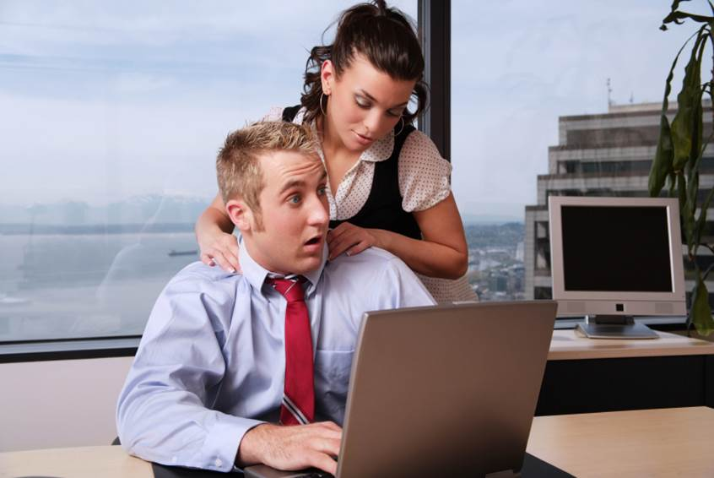
Touching can be turned around
Example of Harassment
It's not always
the guy doing it

Slide 43
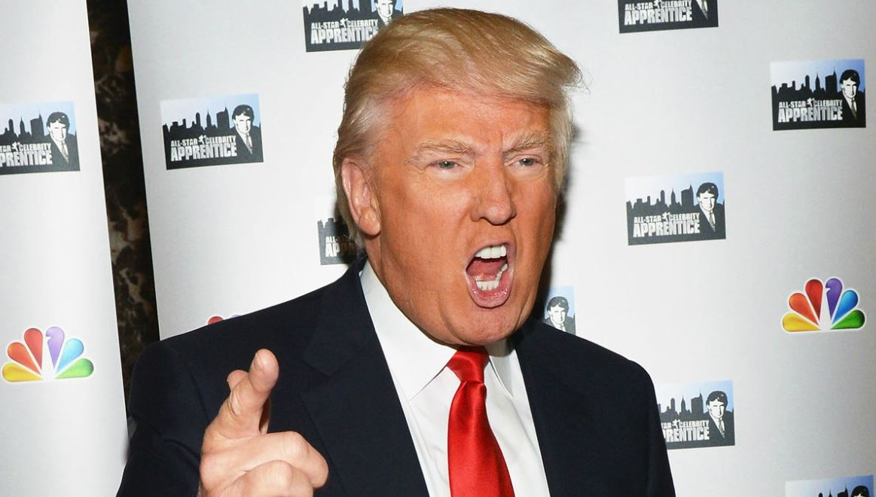
You're Fired!!

Slide 44
EPLI Coverage
TYPES OF
EPLI CLAIMS
Sexual
Harassment
Wrongful
Termination
Failure to
employ or
promote
Discrimination
Breach of
employment
contract

Slide 45
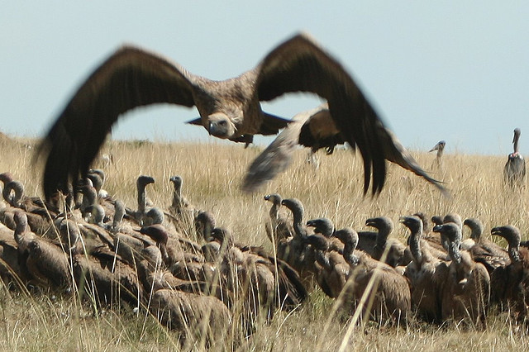
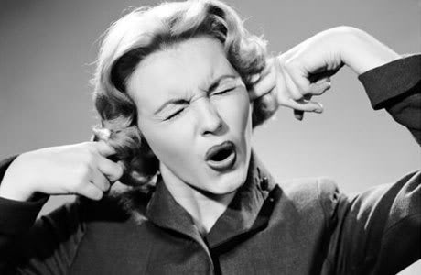

I don't want to hear any more!
Well you finished section one...
Tough, suck it up

Slide 46
Today's Agenda
1.
Event Planner Insurance
2.
Venue Insurance
Requirements
3.
Customer Insurance Needs
4.
Subcontractor
Insurance Needs
5.
What is a Certificate
of Insurance?
6.
What To Do in Case
of an Incident

Slide 47
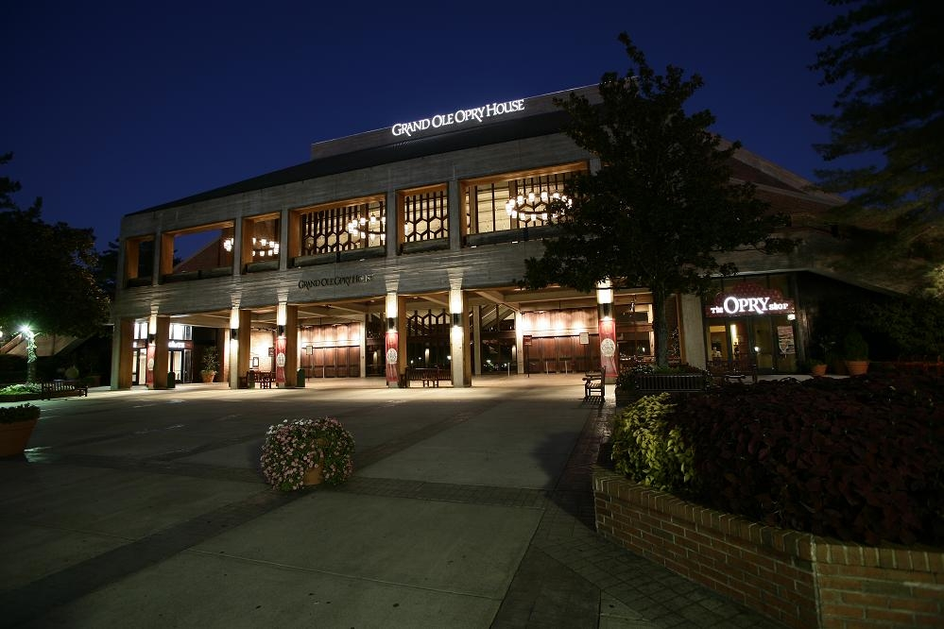
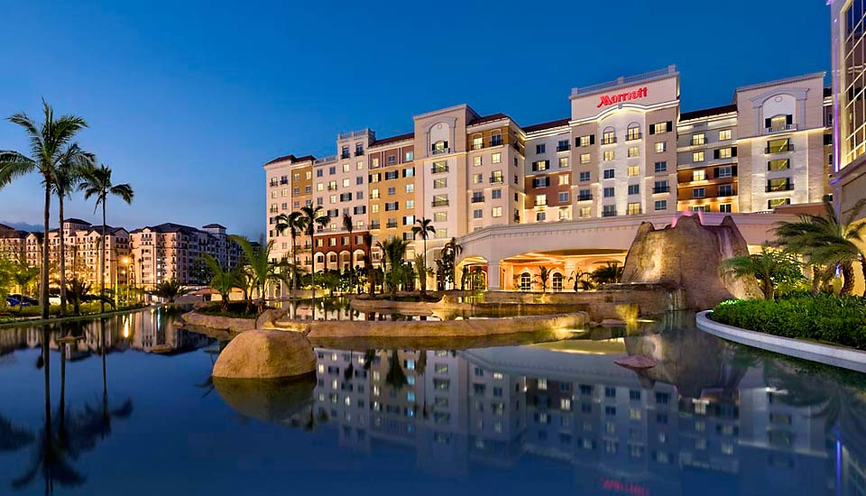
Venue Insurance Requirements
Every venue has different requirements, read the contract and talk with your agent. You can sometimes negotiate the insurance requirements.

Slide 48
Venue Insurance Requirements
General Liability for the event naming the venue as additional insured
Required limits start at $1,000,000 and several have gone to $5,000,000
Venues should always request certificates of insurance from anyone coming onto the premises and providing a service that is not an employee.

Slide 49
Venue Insurance Requirements
Venues should always require
Event Liability Insurance
Liquor Liability
Commercial Auto
Workers Compensation

Slide 50
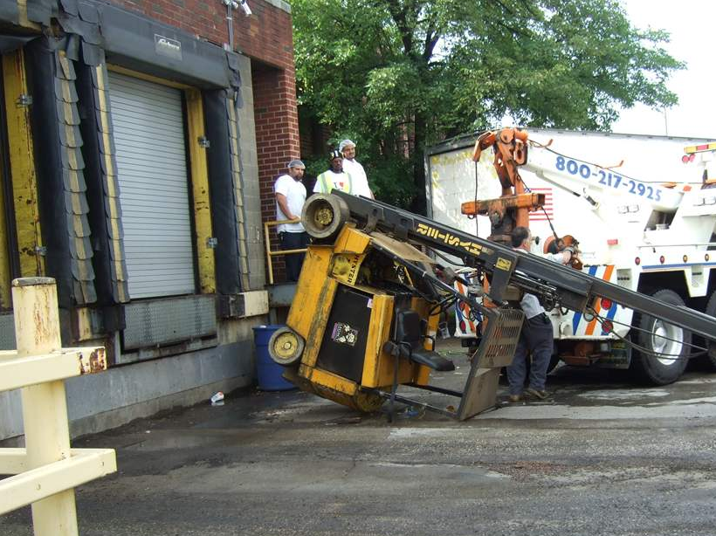
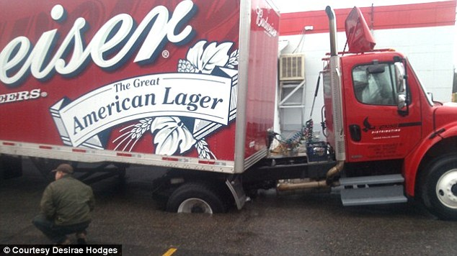
From every company that sets foot on the premises

Slide 51
Entities that would be named in a lawsuit against the venue
Caterer
Tent Rental
Event Planner
Venue
Entertainment
Customer
Activities
So if there is a claim for a covered activity during setup, during the event, and take down, the policies would provide defense coverage for the venue
Stage
Decorations

Slide 52
Today's Agenda
1.
Event Planner Insurance
2.
Venue Insurance
Requirements
3.
Customer Insurance Needs
4.
Subcontractor
Insurance Needs
5.
What is a Certificate
of Insurance?
6.
What To Do in case
of an incident

Slide 53
Customer Insurance Needs
Event Insurance providing general liability coverage, usually $1,000,000 limit
If they are renting anything, they might need third party damage liability
Make sure all subcontractors name your customer as additional insured

Slide 54
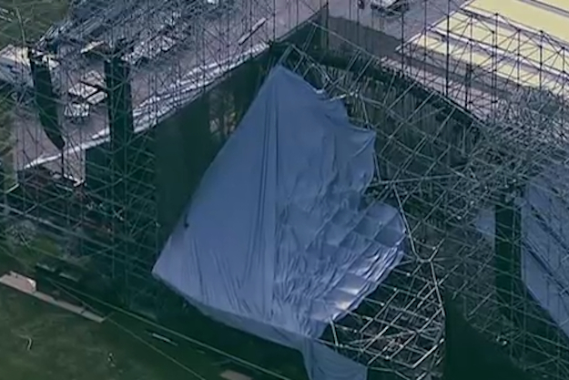
Event Cancellation Insurance
Event cancellation insurance protects organizers against the financial impact of their event being cancelled, abandoned, rescheduled or postponed. Event cancellation insurance policies can include coverage for natural disasters such as fires, earthquakes, flood, power-outages, etc., non-appearance of performers, severe weather, war, or terrorism. The dollar amount of coverage would include ticket sales, sponsorship monies , or advertising revenues from sponsorship are all sources of revenue that can be protected by event cancellation insurance.
Coverage usually has to be bound 2 weeks before the event.

Slide 55
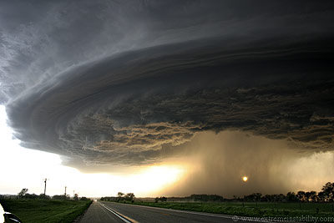
Weather Insurance
Rain insurance coverage protects your outdoor event from lost revenues due to the occurrence of rain concessions reduced ticket sales, etc.
Coverage can also be structured to recover any un-recoverable expenses that your event may liable for even though it is rained out. Things like featured entertainment, venue costs, corporate sponsorships, most hard costs..
Usually the threshold is set for the amount of rainfall. If it exceeds this amount the policy coverage kicks in. Example accumulated rainfall on 1/31/14 at Nashville, Tn over .5” between 10 am and 4 pm.
Wind insurance is usually purchased for outdoor events such as hot-air ballooning, tenting or staging activities that are exposed to high winds. Wind insurance is available to protect any event from loss of revenues due to high winds.
Weather insurance usually has to be bound 7 days before the event

Slide 56
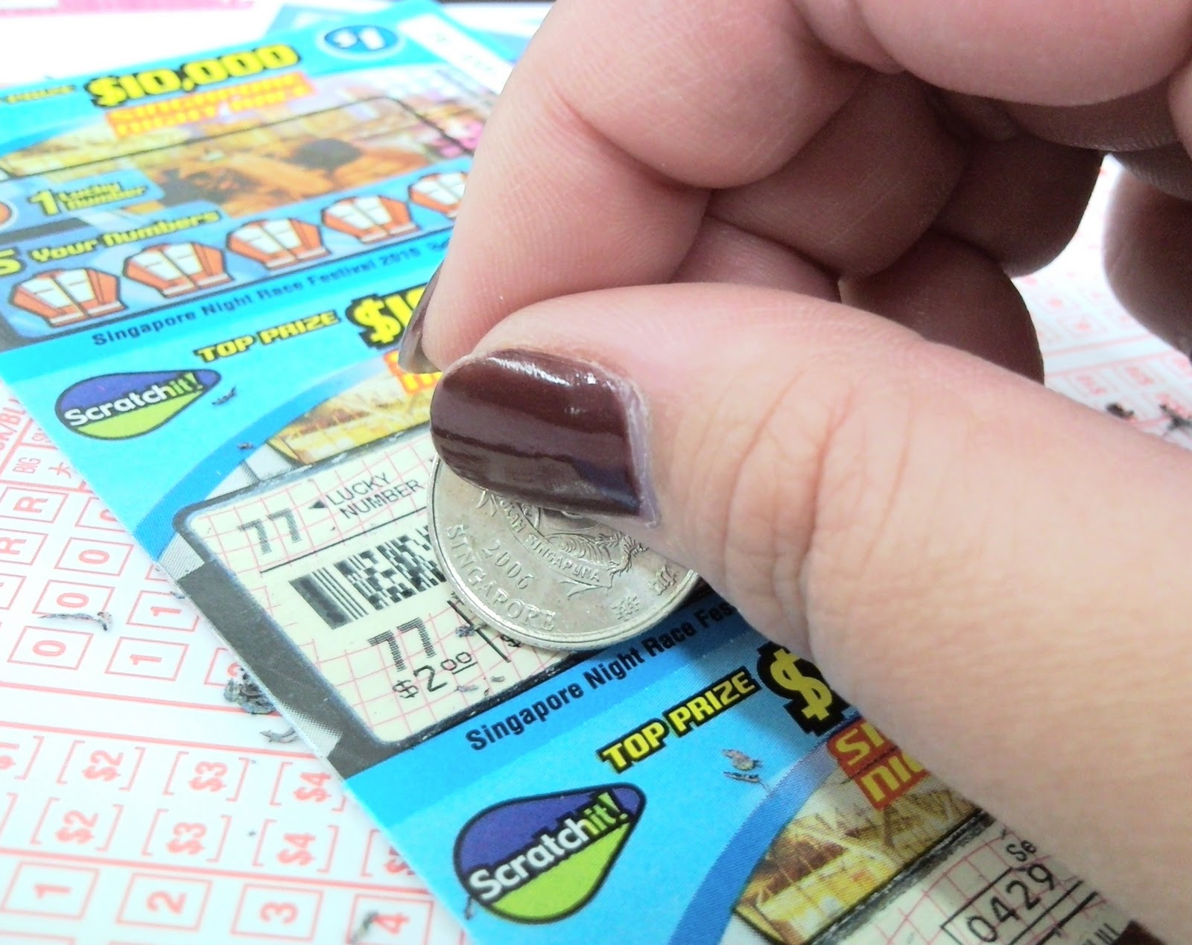
Prize Insurance

Slide 57
Today's Agenda
1.
Event Planner Insurance
2.
Venue Insurance
Requirements
3.
Customer Insurance Needs
4.
Subcontractor
Insurance Needs
5.
What is a Certificate
of Insurance?
6.
What To Do in Case
of an Incident

Slide 58
Subcontractor Insurance Needs
The Sub Contractor should provide you:
General liability
Commercial auto
Workers compensation
Make sure that they name you as additional insured
Check list for each event

Slide 59
Insurance Required
Example Checklist
Business | Cert Rec’d | General Liability | Commercial Auto | Workers Comp
Tent Rental | 7/7/14 | X | X | X
Caterer | Need | Need | Need | Need
Entertainment | 5/5/14 | X | Need | Need
Stage | 5/6/14 | X | X | X
Lighting | Need | Need | Need | Need
Decoration | Need | Need | Need | Need
Activities | 7/1/14 | X | Need | Need

Slide 60
Subcontractors that could be sued
Caterer
Tent Rental
Event Planner
Entertainment
Venue
Attorney
Activities
Stage
Decorations

Slide 61
REMEMBER!
You can't be a little bit pregnant!
You can't be a little pregnant.

Slide 62
Subcontractors to be insured
Where is the risk?
Tables & Chairs
Tents
Entertainers
Caterers
Florists
Stage

Slide 63
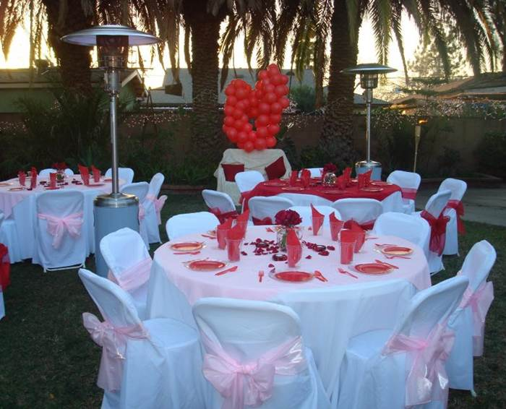
Subcontractors to be insured
Where is the risk?
Tables & Chairs

Slide 64

Anybody out there rent tables and chairs?
Incredibly, one out of every 10 injury claims reported to ARA Insurance Services results from a chair collapse.

Slide 65

Table and Chairs Claims
A guest sat down on a rented chair at a large event and the chair broke. The guest alleges he tore his rotator cuff in the fall and had to have surgery to repair the injury. The rental store was not informed of the loss when the chairs were returned and disposed of the broken chair after they inspected it.
$

Slide 66
Chairs were rented for a meeting. A guest sat down on the chair and the front leg snapped and broke off. The guest fell forward onto her knees and tried to catch herself with her hands. The guest alleged she suffered from back pain and headaches after the fall. The chair leg was reported to be rusted. The rental store had recently painted all of the chairs prior to this event and did not notice the rusted leg.

Slide 67
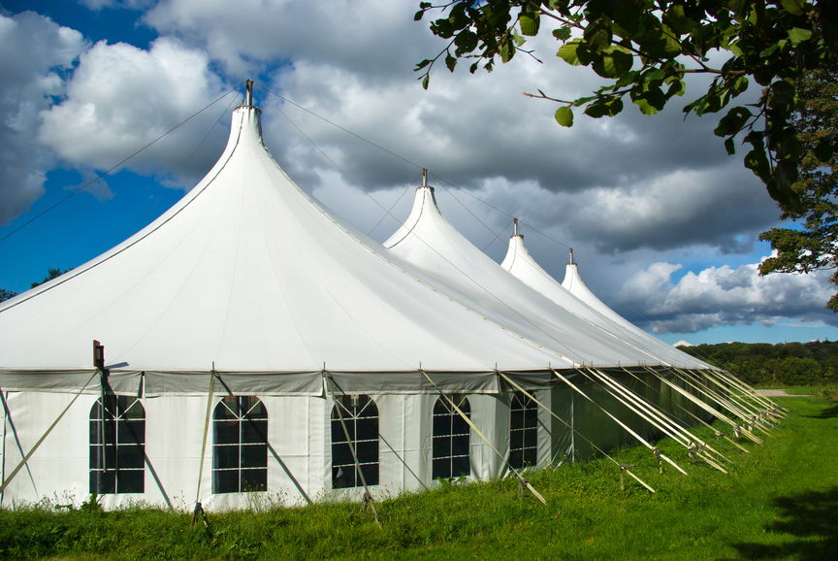
Subcontractors to be insured
Where is the risk?
Tents

Slide 68
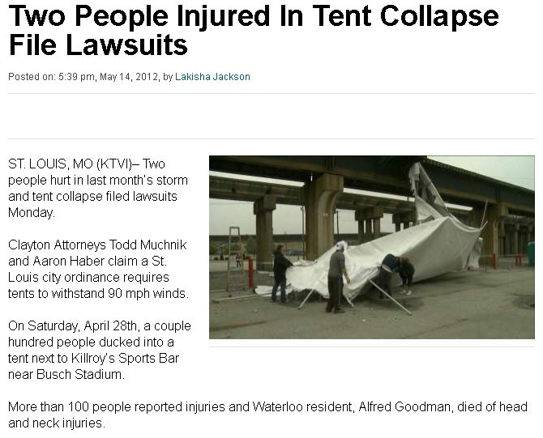
Examples of injuries at events

Slide 69
5 year old boy was killed at
2008 Air Show
The family of Josiah Miller, a 5 year old boy who was killed at the 2008 Air Show at the Huntsville International Airport, has filed a wrongful death lawsuit against the organizers of the air show, the Huntsville-Madison County Airport Authority and All Needz Rental. They claim that those groups share responsibility for the accident that led to Josiah's death.
According to the family's complaint, Josiah and Jason Miller, his father, took shelter behind one of the tents during a thunderstorm. Several of the tents became dislodged because they were inadequately fastened down, and a large air conditioner attached to one of the tents fell on Josiah, causing fatal injuries.

Slide 70
5 year old boy was killed at
2008 Air Show
"Our investigation has concluded that this was a preventable tragedy caused by negligent conduct," the Millers' attorney told the Huntsville Times.Negligent Set-up, Lack of Safety Inspection, Code Violations Blamed for Child's Death.Improper tent set-up: According to the tent manufacturer's instructions, the tents needed to be pitched and staked individually, then secured with four pegs at the corners. Instead, the lawsuit alleges, the group of tents was erected in a line, with pegs securing one side, water barrels holding down the other, and no securement at the sides. To save money, prisoner labor rather than trained installers was brought in to pitch the tents.
Properly anchored, the tents should have been able to withstand winds of up to 60 mph, according to All Needz. The winds on the Sunday that Josiah died were recorded at 48 mph.

Slide 71
One Dead, 100 Injured
(4/30/12) - An Illinois man was killed and about 100 people were hurt when high winds caused a deadly tent collapse outside a St. Louis sports bar, the Associated Press reports. The deadly St. Louis tent collapse occurred when a sudden gust of wind shattered the aluminum poles holding up the tent. Debris flew through the air as the tent was blown onto nearby rail road tracks. About 200 people were underneath the tent when it collapsed. About 100 victims were treated for injuries at the scene, and 17 were taken to hospitals, the AP reports.

Slide 72

Subcontractors to be insured
Where is the risk?
Caterers

Slide 73
Top 9 foods most likely to
cause food poisoning
1. Leafy Greens
2. Raw Eggs
3. Meat
4. Oysters
5. Sprouts
6. Cantaloupe
7. Raw Milk
8. Tuna
9. Berries

Slide 74

Subcontractors to be insured
Where is the risk?
Florists

Slide 75
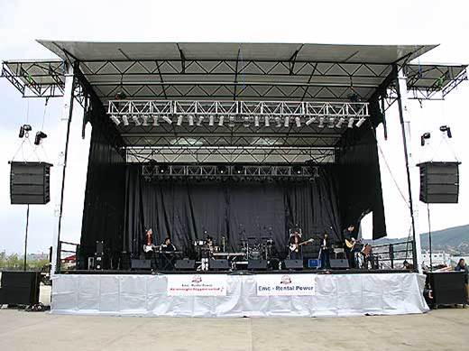
Subcontractors to be insured
Where is the risk?
Entertainers
Stage

Slide 76
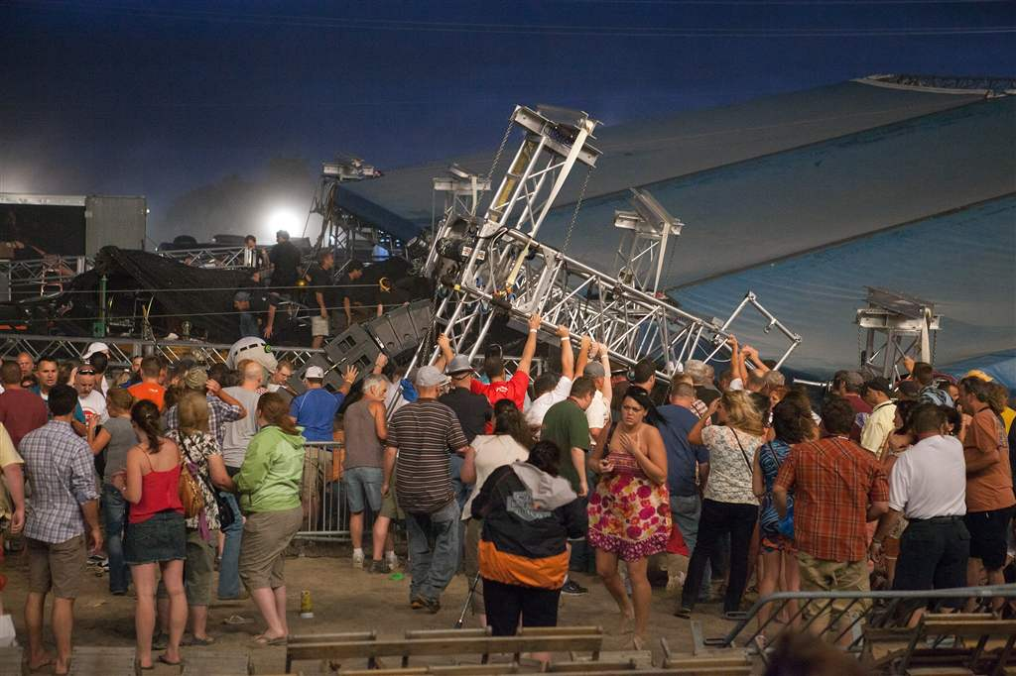
Examples of injuries at events

Slide 77
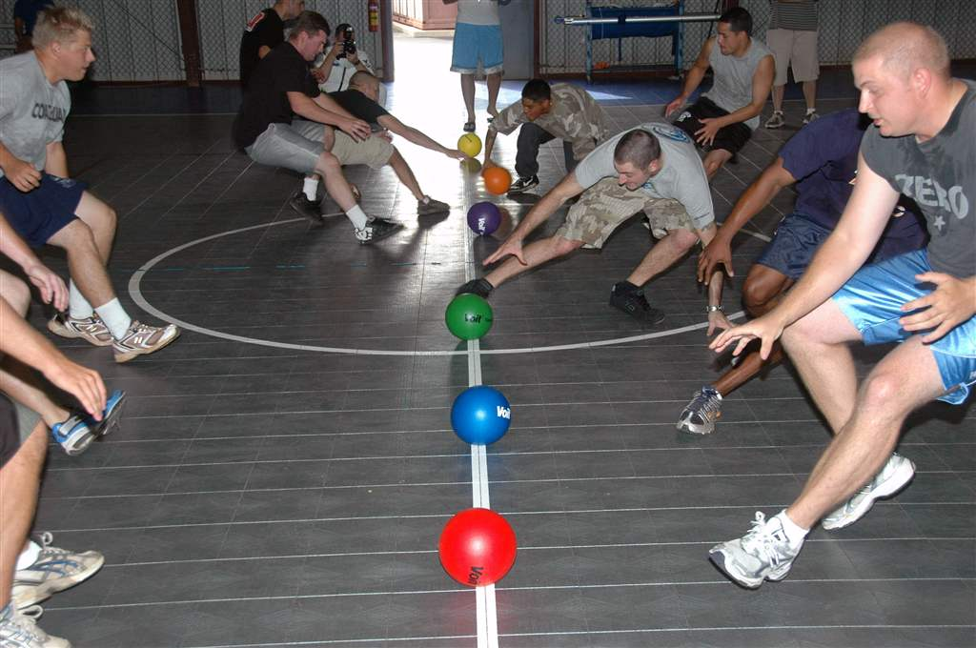
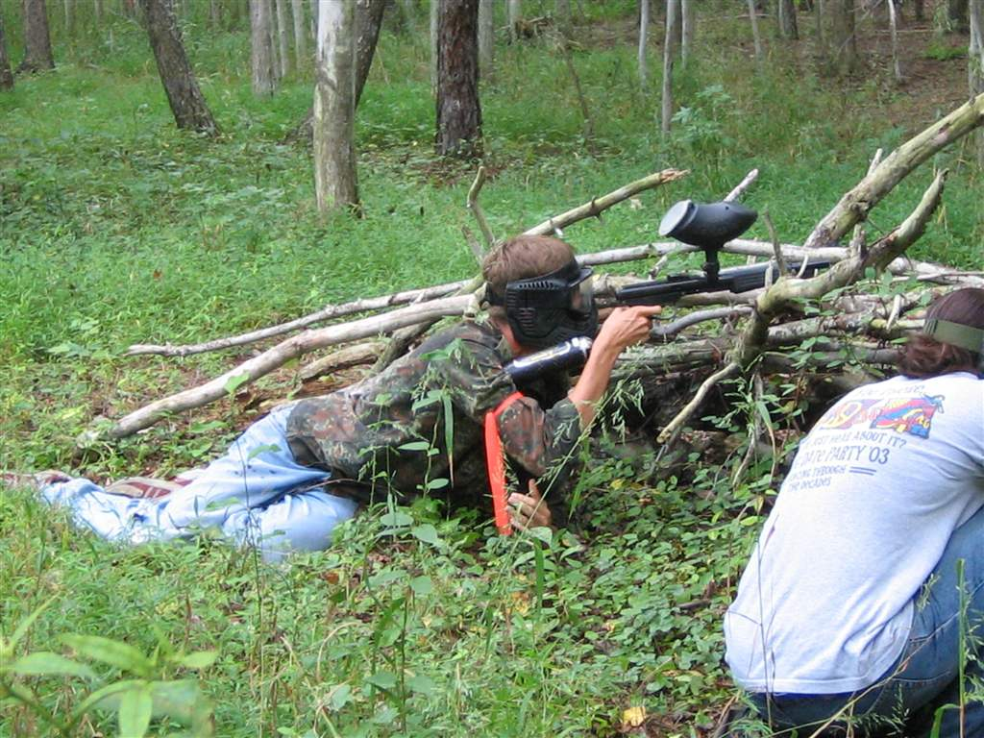
Examples of injuries at events

Slide 78
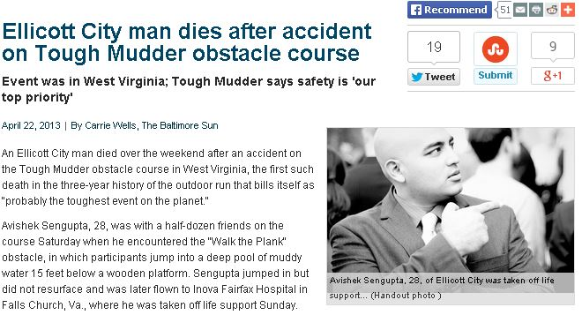
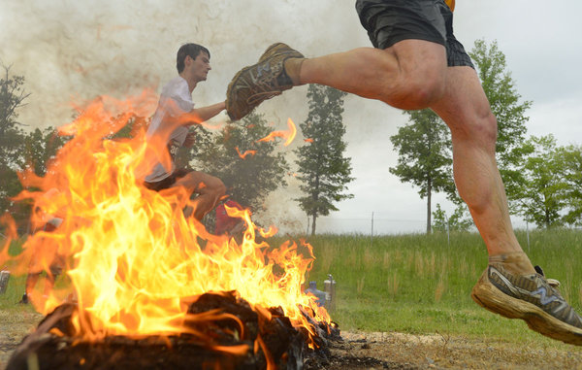
Examples of injuries at events
Tough Mudders &
Mud Run Events

Slide 79
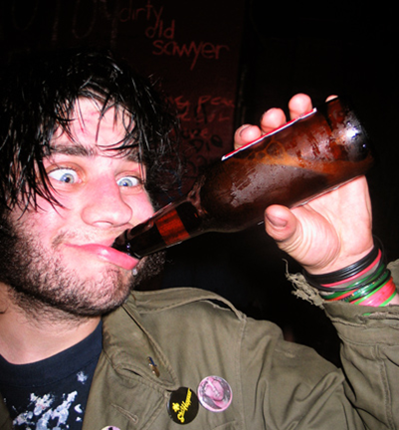
Now I have
you worried!

Slide 80
Today's Agenda
1.
Event Planner Insurance
2.
Venue Insurance
Requirements
3.
Customer Insurance Needs
4.
Subcontractor
Insurance Needs
5.
What is a Certificate
of Insurance?
6.
What To Do in Case
of an Incident

Slide 81
What is a certificate of insurance?
Evidence of insurance coverages and limits
Can show liability, umbrella, property, commercial auto, and work comp
It verifies that a certain insurance policy is in effect for stated amounts and coverage and names those insured
Let’s look at what you need to see on a certificate of insurance

Slide 82
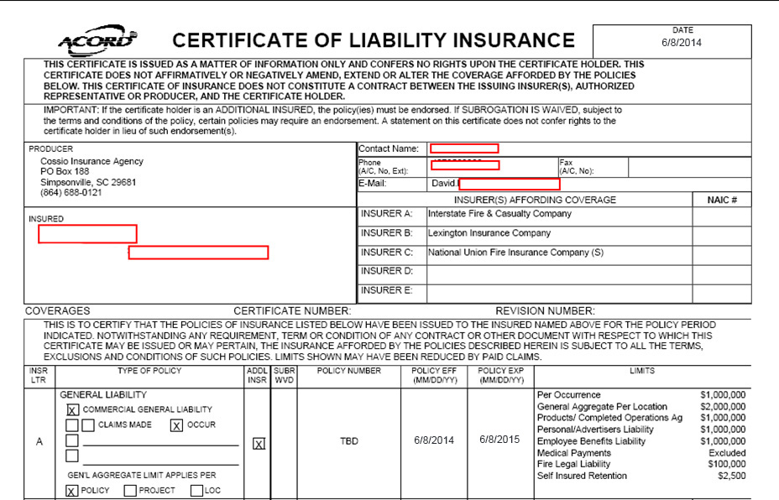

Slide 83
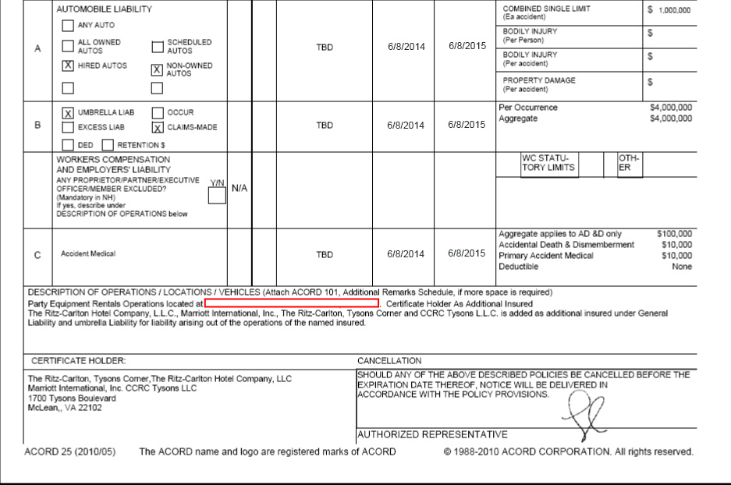

Slide 84
Certificate of Insurance Notes
You need to be named as additional insured with all subcontractors
Certificate holder does you NO GOOD
Always ask for the endorsement
Always ask to have certificate sent from agent

Slide 85
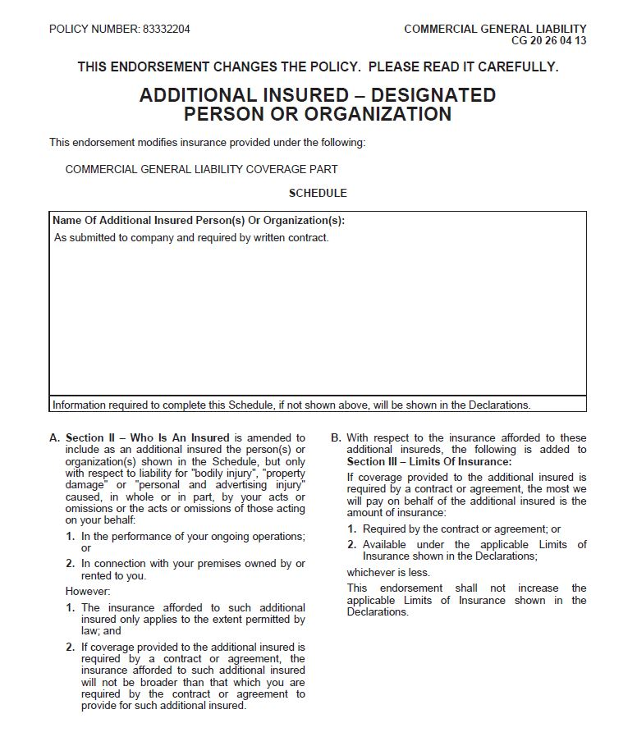

Slide 86
Today's Agenda
1.
Event Planner Insurance
2.
Venue Insurance
Requirements
3.
Customer Insurance Needs
4.
Subcontractor
Insurance Needs
5.
What is a Certificate
of Insurance?
6.
What To Do in Case
of an Incident

Slide 87
What to do in case of an incident
Complete incident report immediately
Acquire names, addresses, phone numbers of all parties and witnesses
Have employee write complete description of incident
Take Pictures
Make sure you report immediately to your insurance agent
Get confirmation that it was received by
your agent

Slide 88
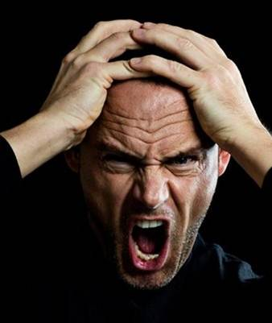

I HATE THE INSURANCE GUY!

Slide 89
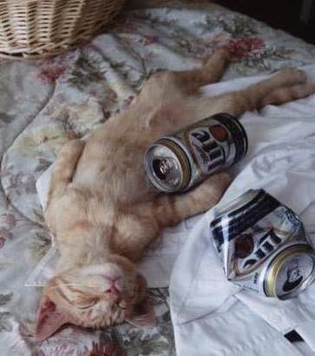
No more speakers...

Slide 90
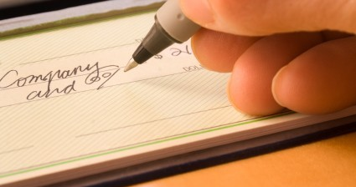
You can buy the correct insurance policy, or…..
write a check for damages and attorney costs

Slide 91
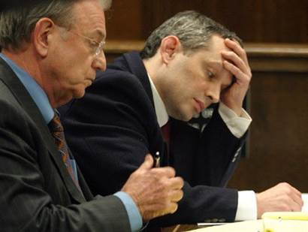
You should’ve made the time to review that insurance….

Slide 92
REMEMBER!
You can't be a little bit pregnant!
You can't be a little pregnant.

Slide 93
THANK
YOU
do you have
any questions?
35

